Slide 1
e-Commerce Shopping Store (eCSS)
Presented By:
Ankit Jangid
Akshita Vijay
Ankit Shisodiya
Akshit Sharma
Yashika Gupta

Slide 2
Overview
This project is aimed at developing an eCommerce Shopping Store Application (eCSS) for applicants.
The primary function of this application is to add products to cart and then place the order after confirming address and contact number.

Slide 3
Users
There are two types of users:
1.Admin
2.Customer

Slide 4
Role Of Admin
Adding new categories details
Updating old categories details
Deleting old categories details
Adding new products details
Updating old products details
Deleting old product details

Slide 5
Role Of Customer
Register as a new customer
Login into the application
Adding products in cart
Placing order
Deleting products from cart
Search products on the basis of product name
Filter products based on category

Slide 6
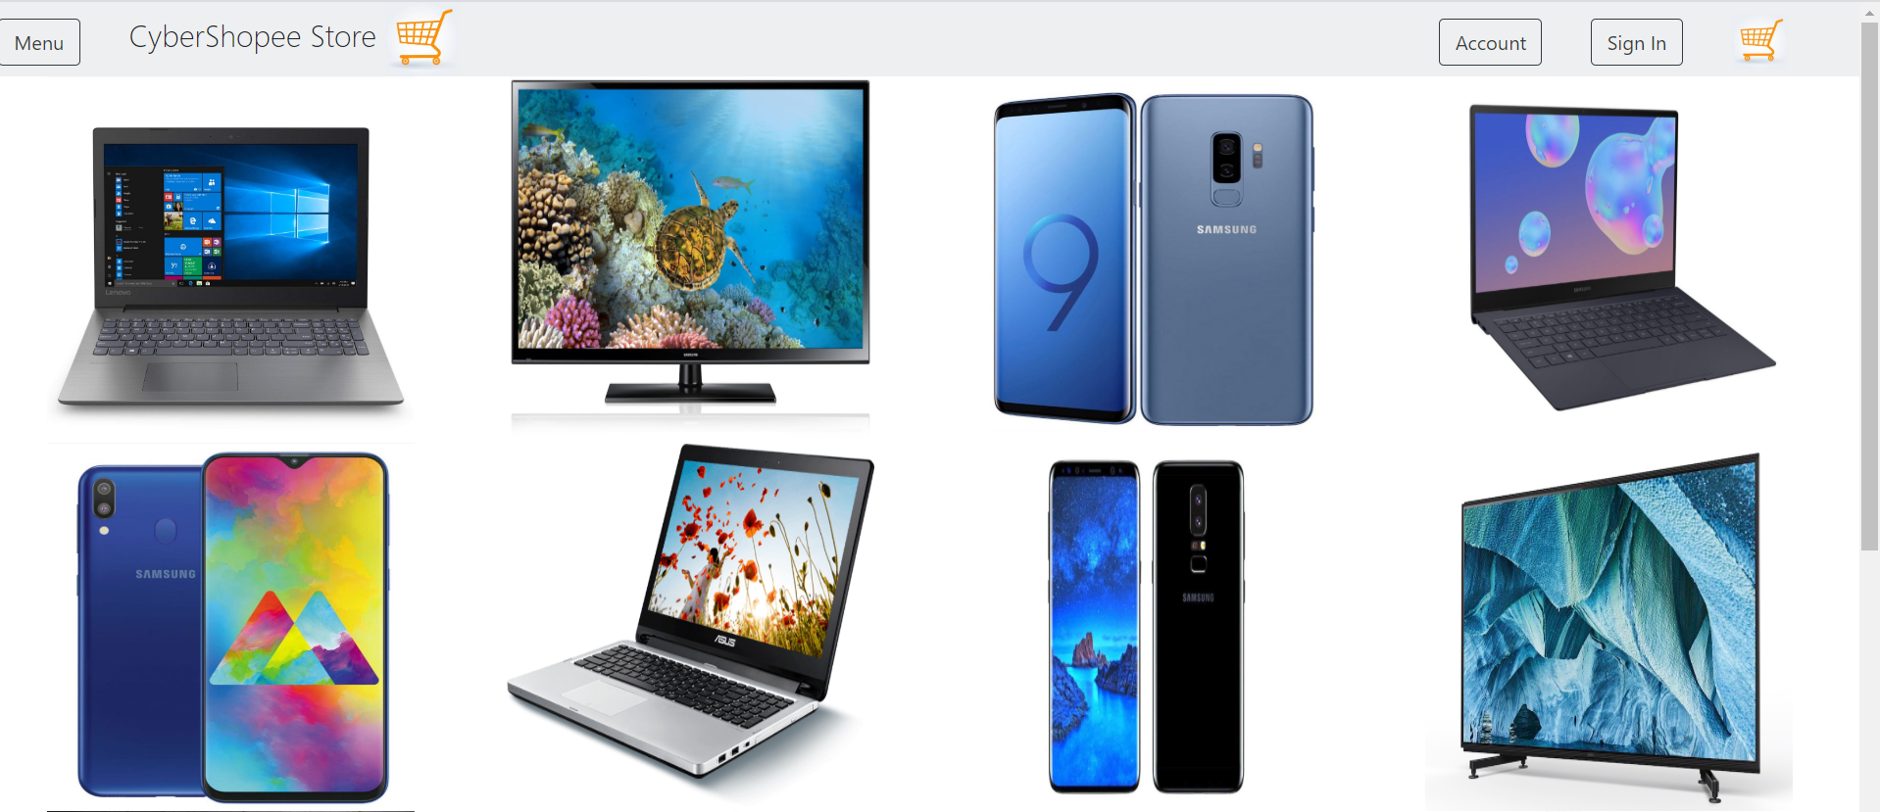
Homepage Of Application

Slide 7
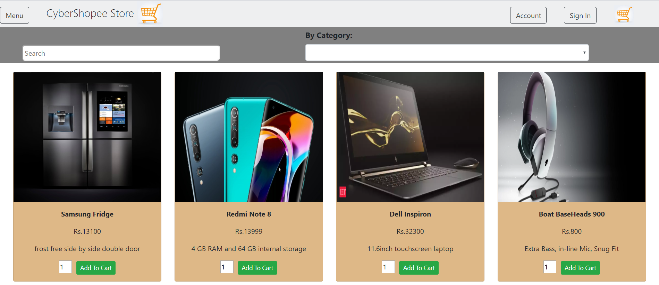
All Products Page

Slide 8
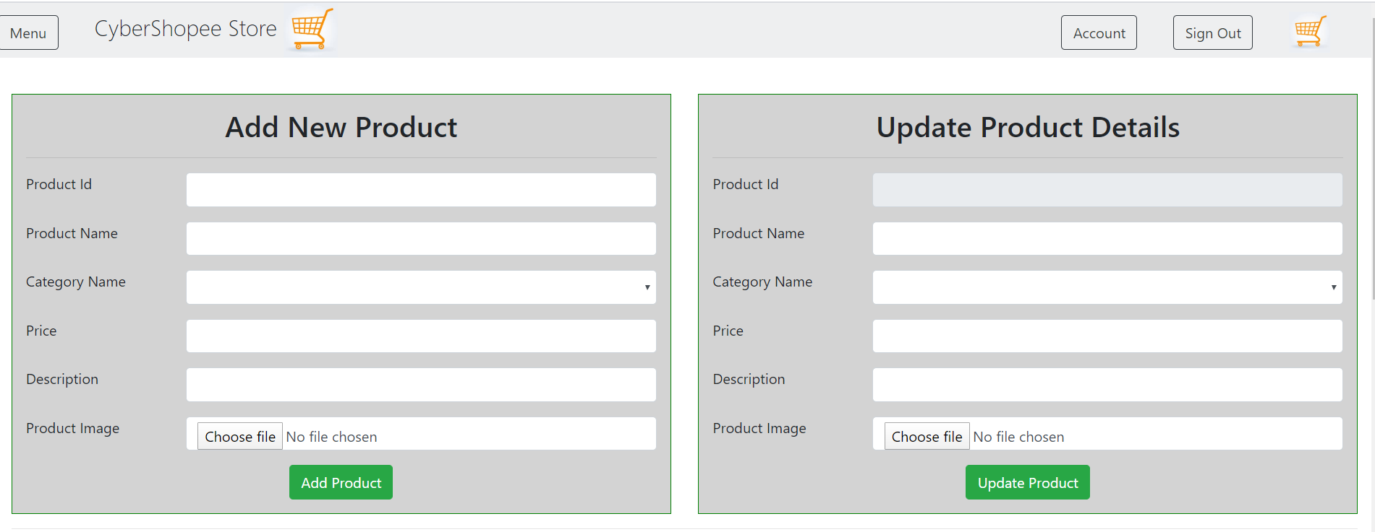
Add & Update Product Form

Slide 9
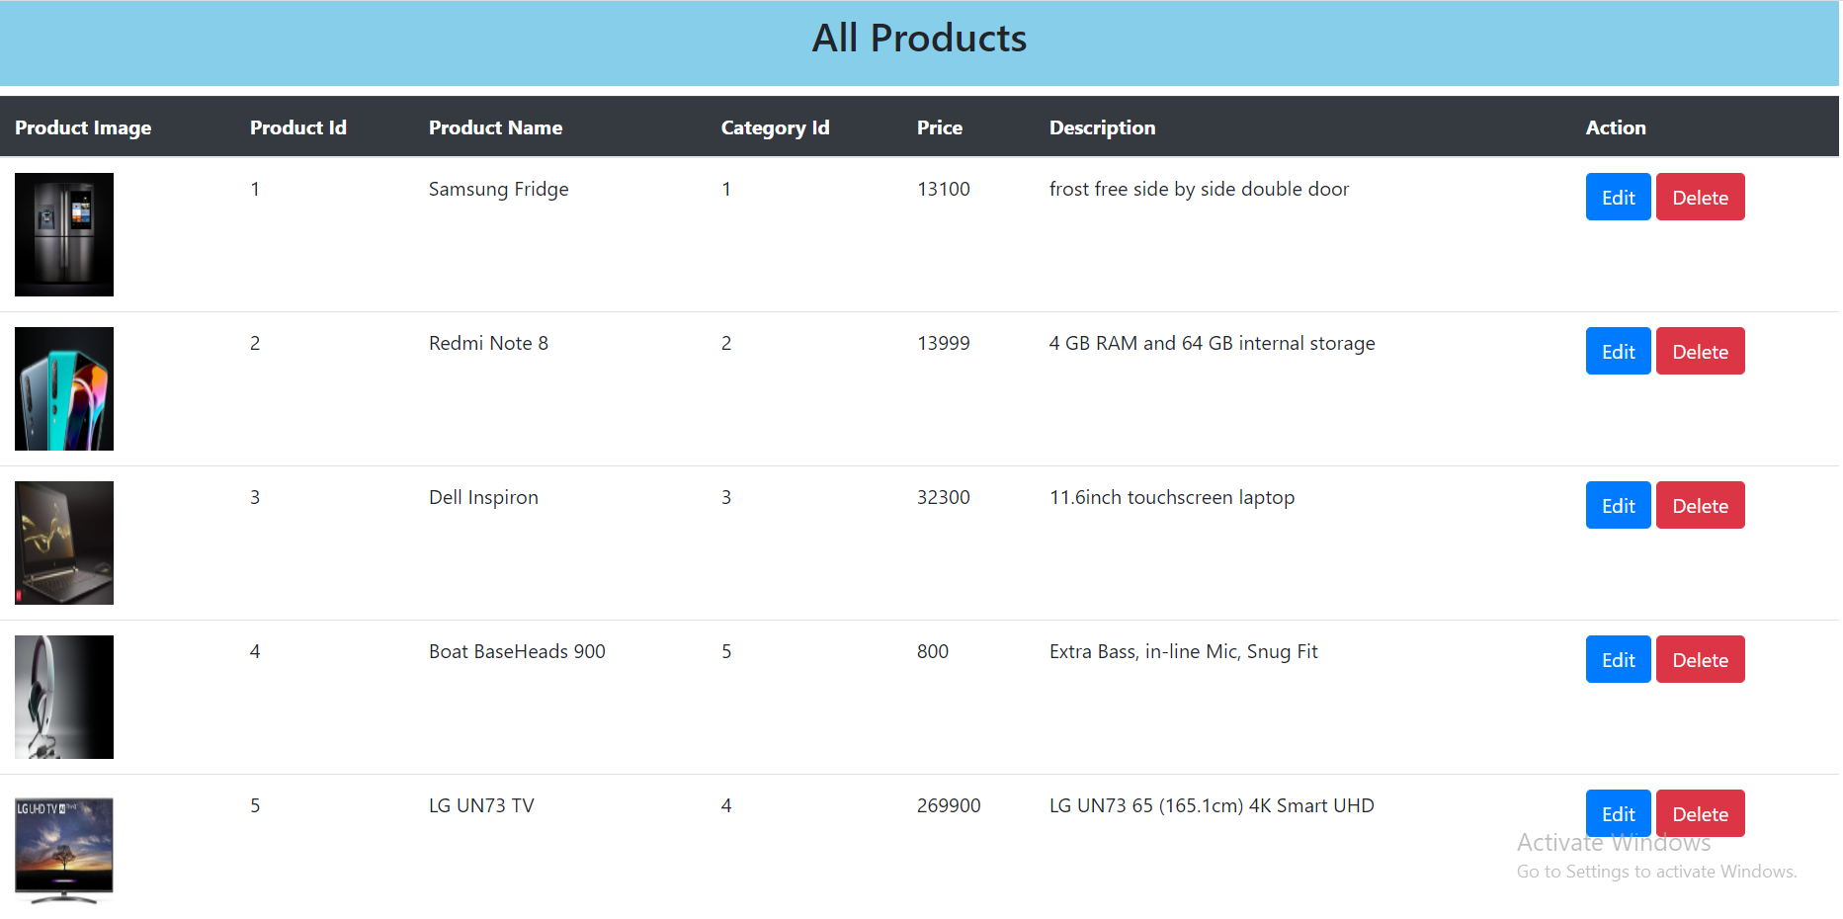
Admin All Details Page

Slide 10
Thank You

